Slide 1
Columbia College Title IX Training
Investigator Training

Slide 2
Conduct Prohibited by Title IX
Sex Discrimination
Sex-Based Harassment (irrespective of gender identity or sexual orientation)
  A form of sex discrimination that includes sexual harassment and harassment based on sex stereotypes, sex characteristics, pregnancy or related conditions, sexual orientation, or gender identity, that is quid pro quo harassment, hostile environment harassment, or one of four specific offenses referenced in the Jeanne Clery Disclosure of Campus Security Policy and Campus Crimes Statistics Act (“Clery Act”) as amended by the Violence Against Women Reauthorization Act of 2013
  Dating violence
  Gender-based harassment
  Sexual assault
  Domestic violence
  Stalking
So long as any of the above occurred within an education program or activity.
Retaliation
  Those Who Have Been Retaliated Against or Reported, Testified, Assisted or Participated in an Investigation, Proceeding, or Hearing under this policy

Slide 3
Parties to a Title IX Proceeding
Complainant- a person who is alleged to have been subjected to conduct that could constitute sex discrimination
Respondent- a person who is alleged to have violated the recipient’s prohibition on sex discrimination
Advisors - Advisors are required to be:
  Professionals- Attorneys or experienced advocates
  Adults, capable of understanding the purpose and scope of the process

Slide 4
Title IX Process
College’s Duties:
  Treat complainants and respondents equitably.
  Include a presumption that the respondent is not responsible for the alleged conduct until a determination regarding responsibility is made at the conclusion of the grievance process.
  Take reasonable steps to protect the privacy of the parties and witnesses during grievance procedures. However, when a formal complaint is processed, the Complainant cannot remain anonymous or have their identity not disclosed to Respondent.
  Individuals are encouraged to report sexual misconduct that may also violate criminal law to the College and local law enforcement as the processes are mutually exclusive.
  Upon a formal complaint, the Title IX Coordinator makes contact with Complainant and discusses supportive measures available and considers the Complainant’s wishes with respect to Supportive Measures.
  Determine if a Respondent needs to be removed from the student’s educational program on an emergency basis

Slide 5
Bias and Conflict Basics
Bias and Conflict of Interests Prohibited
Avoid pre-judgment of the case
Keep an open mind and avoid stereotypes
Must uphold fairness and equity and remain impartial and objective throughout the process

Slide 6
Considerations
  Relationship with Party or witness
  Preconceived notions or biases
  Wearing multiple hats
  Any other reason

Slide 7
Process for Bias or Conflict Concerns
Letter of concern to Title IX Coordinator (or Dean of Students if concern relates to Title IX Coordinator)
Look into the matter
Make determination as to removal from role
If removed, appoint alternate

Slide 8
Does Bias Exist?
Fact-sensitive inquiry
Reasonable person standard
Avoid generalizations

Slide 9
Evidence Considerations
Relevance
Credibility

Slide 10
What Is Relevant?
Mantra: Is the fact or information that is being offered likely to prove/disprove an issue in the investigation?
If it is likely to prove/disprove, even indirectly, it is relevant. If it is not likely to do so, it should not be considered.

Slide 11
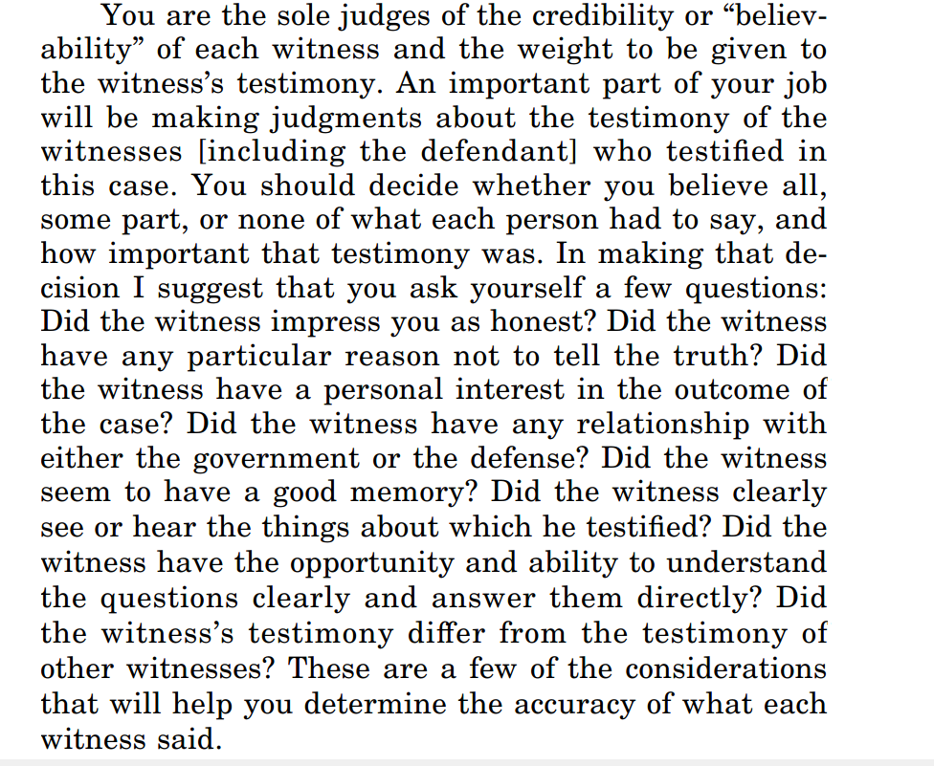
Model Jury Instructions

Slide 12
Relevance and Rape Shield Laws
Relevance: something that has a connection to the question being decided so that it makes one fact or another more or less likely to be true
Not relevant:
  Questions and evidence about the Complainant's sexual predisposition
  Questions and evidence about the Complainant’s prior sexual behavior, except:
    (i) when offered to prove that someone other than the Respondent committed the alleged conduct; or
    (ii) when specific incidents of the Complainant's prior sexual behavior with respect to the Respondent and are offered to prove Affirmative Consent.
  Information protected by a legally-recognized privilege (e.g., attorney-client, physician-patient)

Slide 13
Weighing Credibility
Role
Relationship
Motive
Relevance
Supporting Evidence
Delivery and Demeanor

Slide 14
  Another Note on Determining
  Witness Credibility
  EEOC recommends using the following factors:
  Plausibility: Is the witness’s version of the facts believable? Does it make sense?
  Demeanor: Does the witness seem to be telling the truth?
  Motive: Does the person have a reason to lie?
  Corroboration: Are there documents or other witnesses that support the witness’s version of events?
  Past record: Does the subject of the complaint have a past record of inappropriate behavior?

Slide 15
Seven Factors to Consider
Compare verifiable facts to witness statements.
Are there major inconsistencies in testimony?
Do neutral witnesses corroborate or contradict?
Are there documents such as diaries, calendar entries, journals, notes or letters describing the incidents?
What have witnesses told others?
Have there been similar complaints against the respondent? ***
Do any of the witnesses have a motivation to lie, exaggerate or distort information?

Slide 16
Trauma Informed Approach
Persons involved may have experienced trauma
Could affect Complainants, Respondents or witnesses
May affect how person behaves or interacts
Trauma doesn’t mean a policy was necessarily violated
Appearing “fine” doesn’t mean a policy was not violated

Slide 17
Obtaining Testimonial Evidence
Open-ended questions will generate more information while closed-ended questions will clarify specifics.
When possible, start with open-ended questions (What happened?) rather than close-ended (“Did you go to the bar?”).
Close-ended questions result in yes/no responses that often don’t offer much additional information. Open-ended questions will allow the person to answer as long as he or she desires, possibly yielding more information than requested. Use close-ended questions to obtain specifics and clarify information that you have already received.

Slide 18
Obtaining Testimonial Evidence
Be compassionate and respectful: Keep in mind that questioning, while sometimes necessary, may make the investigation feel adversarial and put both everyone involved on the defensive.
Ask the difficult but relevant questions: Ask the questions that are needed for a thorough exploration of the facts.

Slide 19
Obtaining Testimonial Evidence
Silence is ok:
  Give the witness time to answer
  Silence can make people need to fill in the void and that may cause them to provide more information

Slide 20
Obtaining Testimonial Evidence
Seek other evidence: documents, physical evidence, videos, texts, Facebook posts, other witnesses, etc.
“Anything else?”

Slide 21
Obtaining Testimonial Evidence
Non-verbal communication
  Convey care, concern, and all involved
  Make eye-contact
Verbal communication
  Avoid questions that imply a particular response
  Avoid questions that blame

Slide 22
Some Thoughts on Text Messages & Emails
Can be powerful evidence in these cases, but beware.
Can they be corroborated?
Do you have a complete version?

Slide 23
Seven Steps For Effective Investigations
  Make a plan.
  Collect relevant information.
  Interview complainant.
  Interview respondent.
  Interview relevant witnesses.
  Follow up with complainant and respondent.
  Prepare report

Slide 24
Interviewing Guidelines
Opening and closing statements.
    “I’m here to look into some allegations that have been made.”
    “I want to understand what you have seen or heard.”
    Limited confidentiality (need to know for purposes of conducting investigation and taking corrective action, if necessary).
    Anti-retaliation.
Treat interviewee with dignity.

Slide 25
Interviewing Guidelines
Questions
      Open-ended and broad, not leading
      Chronological
      Tough or embarrassing questions
      Then go to specifics
Allow silence.
Look for contradictions.
Evaluate body language.
Consider the interviewee’s motives.
Be curious. Leave no questions unanswered.

Slide 26
Interviewing Guidelines
Review notes and documentation issues.
Provide adequate time.
Ask witnesses about other witnesses.
Take notes.

Slide 27
Interviewing Guidelines
Closing Statement
  Anything else I should know?
  Any other documents I should review?
  Anyone else I should speak with?

Slide 28
Availability for Hearing
The investigator should be present or available during the hearing

Slide 29
Final Questions?

